Slide 1
Agile Approaches to SW Engineering
By PJ Davies
With Reference to:
  Real-Time UML by BP Douglass.
  ISBN 0-201-65784-8
Use-Case Diagram Tutorial based on Visual Paradigm (tool we will use): https://www.youtube.com/watch?v=tLJXJLfLCCM&list=PL05DE2D2EDDEA8D68
©Paul Davies 2020. Not to be copied, used, or revised without explicit written permission from the copyright owner. This lecture may contain animations and is best viewed as a slide show

Slide 2


Waterfall vs. Agile Models for Development

Slide 3
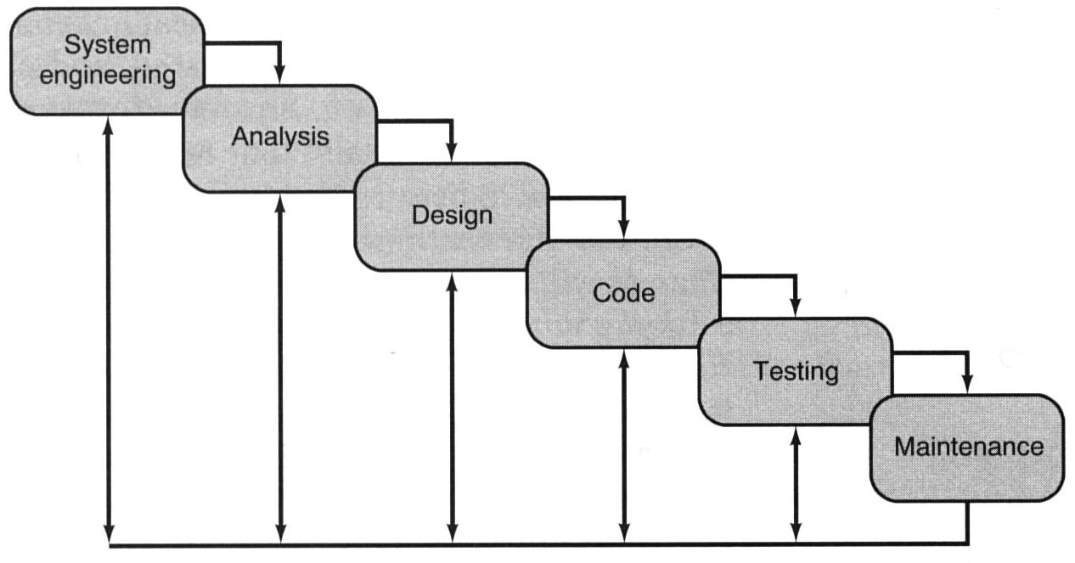
Traditional Waterfall Method
Carefully documents requirements, builds, then tests – minimal iteration.
Emphasis is on detailed specifications, documentation and contracts at start.
Very suitable for many engineering projects where requirements have to be specified up front and when cost of change is prohibitive e.g. building bridges, manufacturing cars etc.
In 2001 many software developers got together to express their dissatisfaction with the waterfall model for software development, which suffered from a general lack of flexibility when faced with “fluid” requirements and customers who do not know what they want. They formed the agile alliance and came up with the Agile Manifesto and the concept of “Agile Methods”.

Slide 4
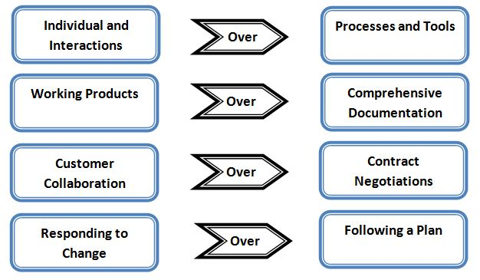
Agile Software Development and the Agile Manifesto
“ We are uncovering better ways of developing software - Through this work we have come to value”
“That is, while there is value in the items on the right, we value the items on the left more” - Kent Beck, et al, "Manifesto for Agile Software Development". Agile Alliance, 2001

Slide 5
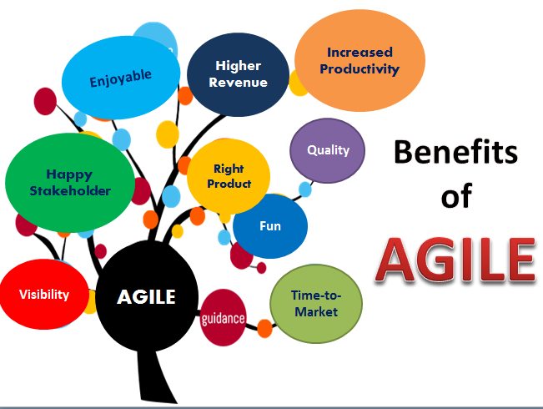
What are Agile Methods?
They are an iterative/incremental approach that adapts better to changing requirements, or as requirements become better understood.
They favour a Collaborative, and Customer-Centric approach to deliver quality working software, on time and within budget, which hopefully keeps everyone happy.

Slide 6
Agile
Requirements Analysis and Gathering
–
User Stories

Slide 7
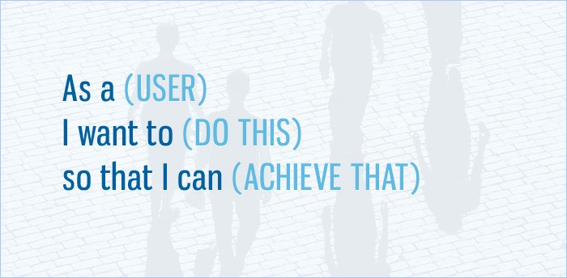
With all new software projects, we begin by gathering requirements.
Agile approaches seek to uncover the functionality required of a system through a process of exploring “user stories”.
User stories are simple descriptions of a feature as told from the perspective of a person who desires it. A user story template looks like this
(see https://www.visual-paradigm.com/guide/agile-software-development/user-story-vs-use-case/)
Question: Imagine you are designing a new type of car, what user stories could you come up with?
What about your favourite “app”. Describe its features as user stories. What are the user stories for a Lamp

Slide 8
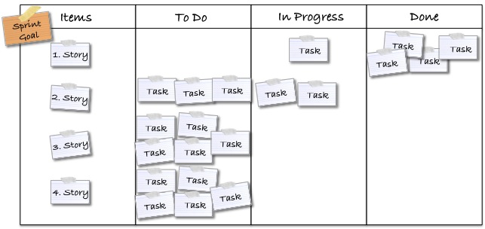
User stories are often written on index cards or stick-it notes, pinned to a white board or wall to facilitate planning and discussion. As such, they strongly shift the focus from writing about features to discussing them. In fact, these discussions are more important than whatever text is written.
User stories are picked up by developers, split into smaller tasks, designed, tested and released as new features in the next “sprint/release”.

Slide 9
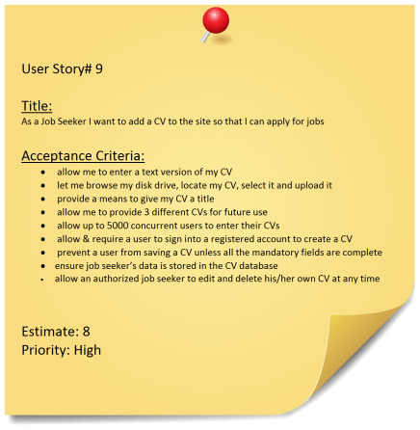
An Example User Story
Consider a user story for a Recruitment Agency. Here the story is written from the perspective of a potential job seeker and has been expanded to include acceptance criteria so we can measure when it’s done, plus a cost estimate (8) and a priority (High) which affects the implementation timeline, i.e. high priority means early release.

Slide 10
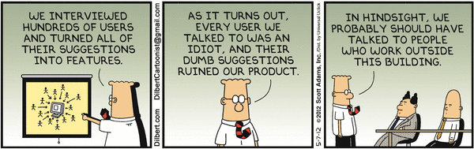
Identifying Stakeholders and Users
When generating requirements/user stories, it’s important to identify all users and stake holders who have an interest in the success of the project.
These people have their own ideas about what the system needs to do.
Sometimes it’s hard to convince “workers” to adopt new technology and accept new ways of doing things, so its important to have them onboard.
The finished system will be a failure if doesn’t do all the things its users want - They may end up not using it (or paying for it).
Source: Dilbert.com

Slide 11
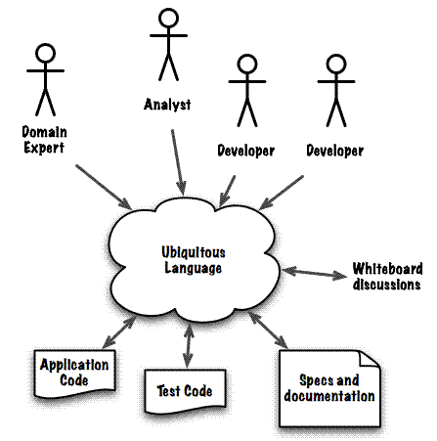

Where Possible, Talk to a Domain Experts
Analysis of requirements is often more successful when conducted in the presence of one or more ‘domain experts’, i.e. someone who is intimately familiar with the business process or procedures that you are trying to automate (i.e. the problem domain) and can describe them to somebody else, often in a non-technical way.
In simple terms, a domain expert is somebody who understands or knows how to do the job before it has been automated. It might be the customer or an employee for example.

Slide 12

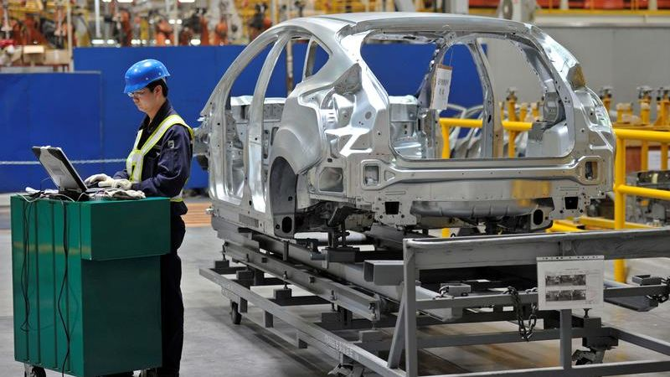

Example Domain Experts
An accountant, is a domain expert in the sense that he/she knows intimately the procedures, forms, rules and regulations to be followed when dealing with Revenue Canada.
Likewise, Architects and Electricians are domain experts when it comes to obtaining advice on building codes and planning regulations for electrical installations.
In a simpler vein, Mary the librarian, or Fred assembling cars for GM are also domain experts since their experience makes them uniquely qualified to comment on the business processes involved.

Slide 13
Example Library User Story
As an example, consider the proposal for automating an antiquated library where books, membership and loan details are currently stored on a paper based card indexing system maintained by a librarian.
Member User Story: “As a member of a library, I want to be able to borrow books so that I can enjoy reading them without buying a copy”
Librarian User Story. “As a librarian, I want to be able to introduce new books to the shelves so that users can borrow them”
How do we turn a story into a set of interactions with Data that we could implement on a computer?
There are a number of different techniques that can be used to uncover this expertise or functionality, but one of the most powerful is to concentrate on user interactions that will take place within the system. These can be uncovered by interviewing a domain expert.
Quick exercise: Think about other user interactions between a librarian and a member. When borrowing a book.

Slide 14
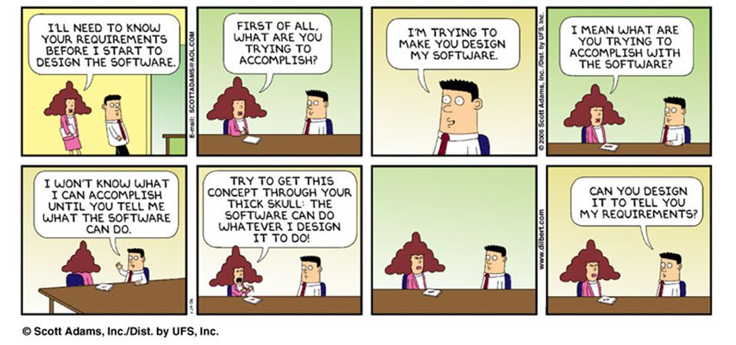
Requirements Analysis is hard, often customers do not know what they want or even what is possible or even if that is the best way to do it.
Developers need time and patience to explore options with the customer.
To be good at requirements analysis, learn to ask open ended questions: what, where, why, when, and how to pull information out a customer. Ask them to describe their current operation, i.e. show you how they do things now!! (See notes on requirements analysis Topic 4)
Source: Dilbert.com

Slide 15
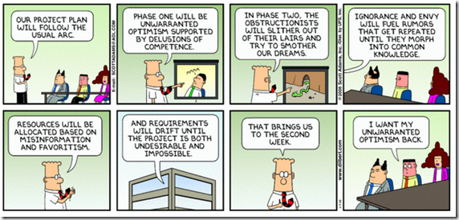
Requirements analysis is made even harder by the fact that even the people in your team have their own egos and hidden agendas leading to infighting.
For example, not all developers will agree about the way to design the software, some will have reservations about whether it’s even possible, or which approach is better and will throw up all kinds of technical and social problems. You may have encountered this in your previous project courses
Source: Dilbert.com

Slide 16
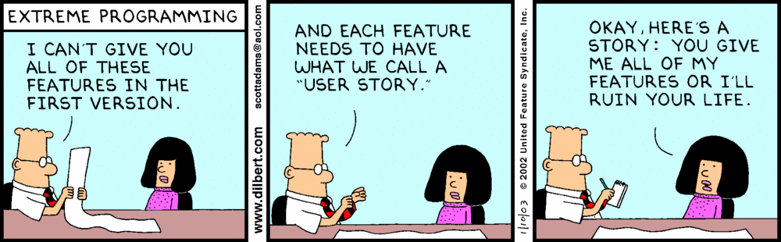
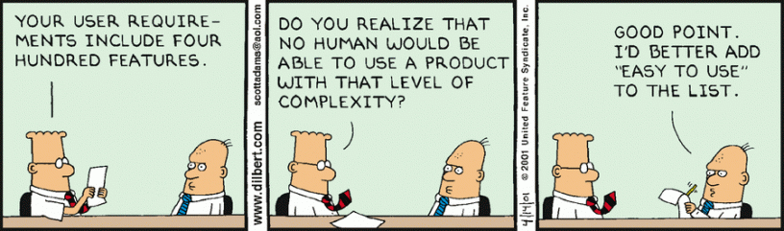
Where do User-Stories fit in to Agile Methods?
The purpose of generating user stories is to create a “product backlog”, i.e. a set of features the system must provide to users. No attempt is made yet to figure out how those goals will be met or who will implement them – that comes later.
As new releases of the software are developed, the focus will be on implementing 1 or more user stories from the backlog.
Source: Dilbert.com

Slide 17

How do Agile Teams work?
Teams divide overall development into a series of Sprints
- Each sprint typically lasts 1-3 weeks
Within each Sprint you attempt to implement 1 or more user stories, that is your team will design, implement, and test a version
- Important: the result of a Sprint is something you can
demonstrate (not just a bunch of code and functions).
- Each version takes us progressively closer to our release version.
Example: consider the development of a “PAC Man game”
The 1st sprint might focus on developing the software that creates and displays a maze on the screen.
The 2nd sprint might implement the single player game strategy etc.
The 3rd sprint might allow for multiple players and customization.

Slide 18
How do Agile Teams work?
Sprints are then broken down into a number of smaller tasks
- Each task involves writing, testing, and integrating a piece of code
- Each task takes no more than a few hours. If it does, then break it down
into smaller tasks as it’s probably too complex to be a single task
So Sprint 1 of our Pac Man game might look like this:
Task 1: Develop Algorithm for Maze design
Task 2: Design look and feel of the Maze. Monsters, food, walls etc
Task 3: Design colour schemes, sound effects etc
Task 4: Draw initial maze taking account game settings, resolution of
screen etc.
There may be 10’s of tasks per sprint.
Tasks may be dependent on other tasks. If they are too complex, they could be broken down into smaller tasks.

Slide 19
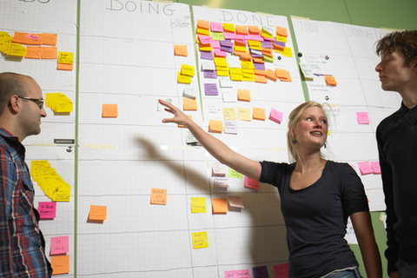
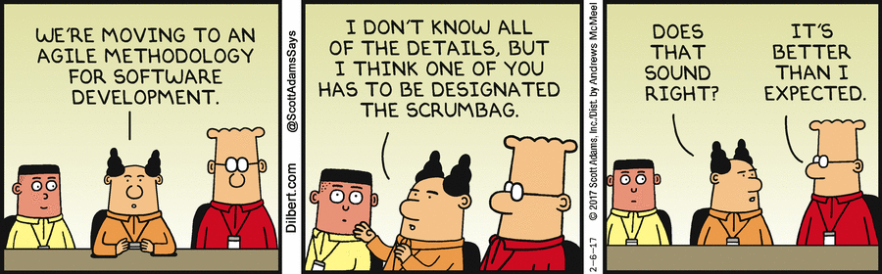
People and Process Management : Scrums
How do we manage and organize people for Sprints?
In many companies the day starts with a scrum. These are short meetings (5 - 15min). Usually, everyone stands to keep it short.
A “scrum master” runs the meeting.
Each group member outlines:
  What they have done since the last
scrum (no demos!)
  What he or she intends to do
before the next scrum.
  Any obstacles preventing progress.
Source: Dilbert.com

Slide 20
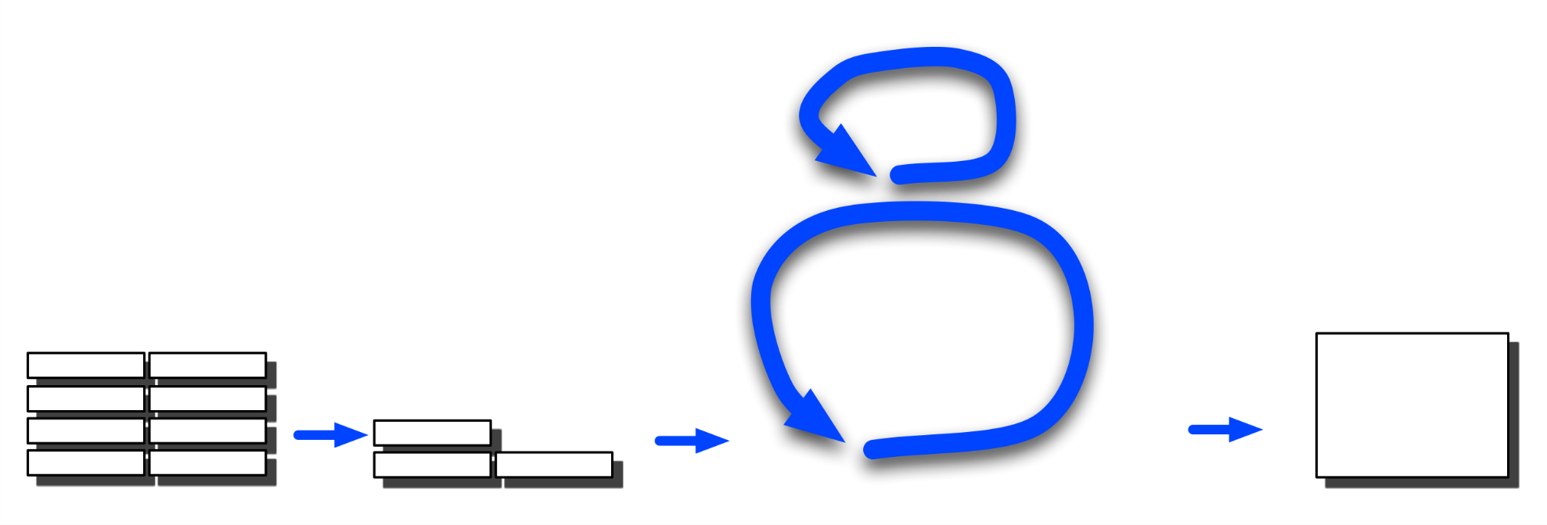
User Story: Proposed by Stake holders, customers etc. Written in the form of
“As a (my role) I want the system to be able to do (my task) so that (benefit to me)”
Scrum Illustration
Daily scrum:
What have I done?
What am I doing?
What is holding me up?
List of product features (User Stories) yet to be implemented
1 day
1-3 Week Sprint
Product
backlog
Sprint
backlog
Sprint:
Design, test and release next version/iteration
“Shippable”
Product
Increment with latest features. Release version may involve many sprints
Prioritised list of features to be implemented in next iteration or sprint. These are broken down into tasks and estimates of time

Slide 21
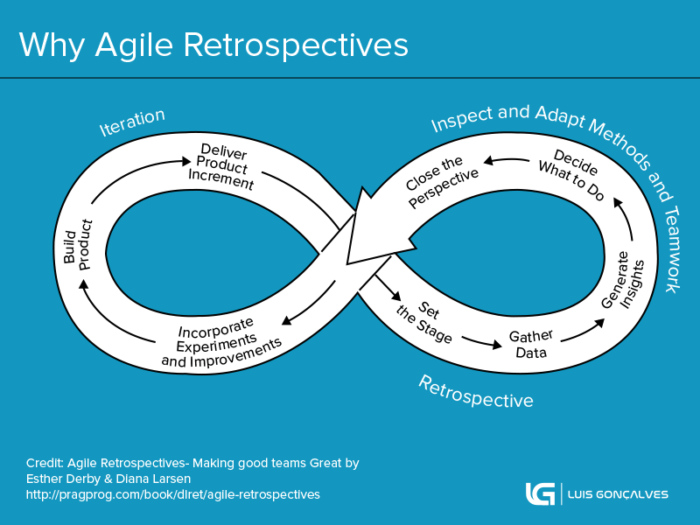
Retrospectives
After each sprint/iteration a “retrospective” is held where the team reflects on what happened in the sprint and identifies actions for improvement going forward, e.g.
  What worked well?
  What did not work well?
  What actions can we take to improve our process going forward?
A retrospective can be thought of as a "lessons learned" meeting. The team reflects and then decides what changes they want to make in the next sprint.
https://searchsoftwarequality.techtarget.com/definition/Agile-retrospective

Slide 22
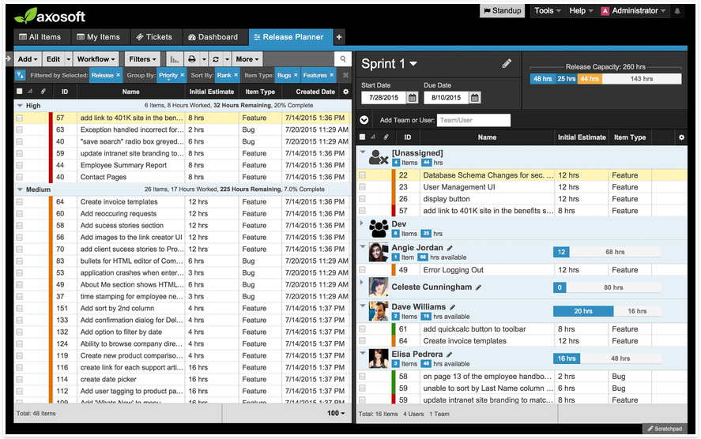
Agile Project Management Tools
There are many types of agile management tools out there.
The above software is from trello.com
Sprint Number
Prioritised Backlog
Elisa’s Tasks: Type and Estimates of Time

Slide 23
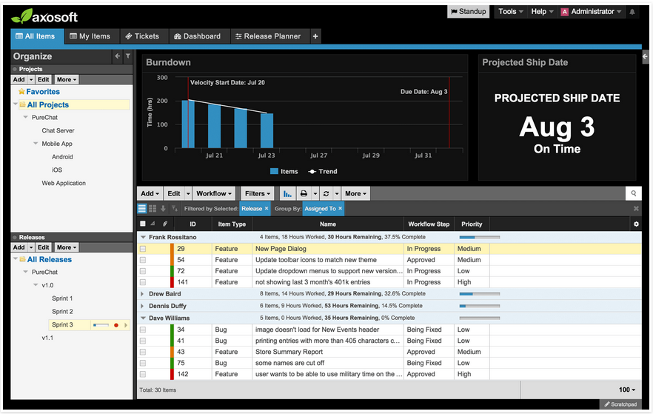
Some tools will contain support for a “burndown chart” which tracks completed tasks against time and allows for estimates of completion of product backlog.
Scrum Video in under 10mins
https://www.youtube.com/watch?v=XU0llRltyFM

Slide 24
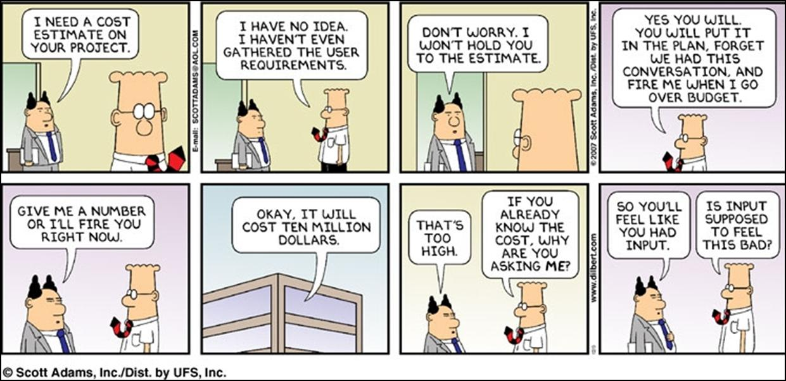
Cost Estimation
One of the hardest things about agile approaches like scrum, is the difficulty estimating the total cost of the project up front. User stories don’t give you much to base an estimate on.
Source: Dilbert.com

Slide 25
Dealing with Budgets and Prioritising Development – The MoSCoW Method
Its human nature that customers will always want all the features they ask for, but they don’t have unlimited budgets to pay for them all.
We want to keep our customers satisfied, but what can we do?
One approach used in project management that is also applicable to software is to develop according to the MoSCoW method (https://www.toolshero.com/project-management/moscow-method/ )
Here we ask the customer to prioritise their user-stories on the basis of :-
  “Must-Have” (Essential – system cannot function without that feature)
  “Should-Have” (Important but can be done after Must-Have features)
  “Could-Have” (Nice to have features, if time and budget permits, but the system could work without them)
  “Won’t/Would Have” – Wish list features that could be tackled down the road when the client has a new budget- perhaps next year.

Slide 26
Cost Estimating…cont
How do we estimate cost of implementing features – it’s difficult
The only definitive answer is to look back at what it actually cost you !!!
That may sound obvious, but it’s a useful approach, you can use this experience and retrospective data to produce more accurate estimates in the future e.g. I’ve done this kind of thing before, therefore I have the experience to know roughly what it will cost in the future.
This means that established, experienced companies are more likely to be able to predict software costs than new, inexperienced companies.
There is no way that a company that has spent 10 years developing say “Cloud Based Web applications” is even going to be in a position to tackle a “Safety-Critical, Real Time Embedded System” and you'd be crazy as a customer to hand them that project. Not only will it (probably) be a disaster, their time and cost estimates will be way off.
They will not have the experience to know that safety critical software has to be developed using formal methods (mathematical proofs of correctness) and will often require certification by a standards body which costs lots of $$$, and takes a huge amount of time.

Slide 27
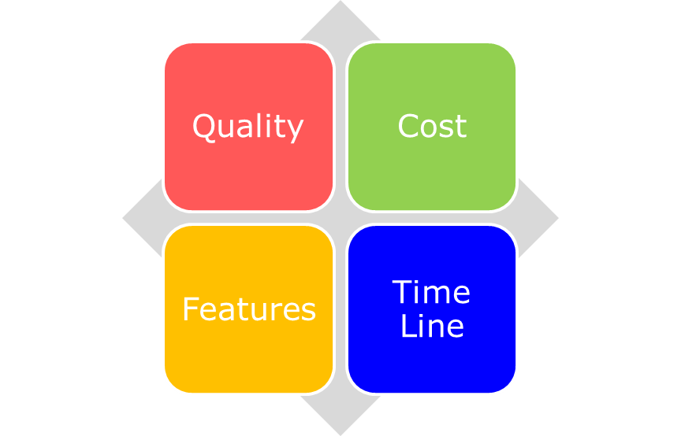
Controlling Costs
Another way to keep a handle on costs is to not give the customer control over everything that’s important: Time Line, Quality, Cost and Features.
Let them choose 3 of these, but you retain control of the 4th.
For example, if the customer wants a high quality system with all the features, delivered in 6 months, you retain control of the cost.
If customer has a fixed budget, short time line and wants high quality, you retain control over the features delivered.

Slide 28
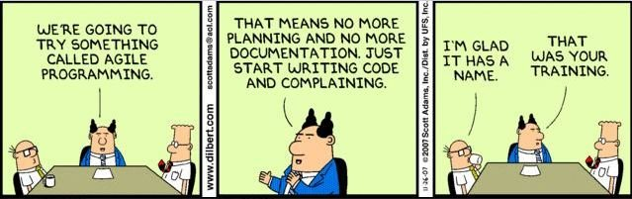
Drawbacks to Agile Development
Agile development works well for some projects especially when requirements and/or technology are not well understood or are changing.
It’s main criticism is that project management is often non-existent (let’s be generous and call it adaptive) and that the only real documentation is the Source code itself.
It is also dependent on the idea that :-
    “the software will be ready when it’s ready and will cost whatever it costs”.
Source: Dilbert.com

Slide 29
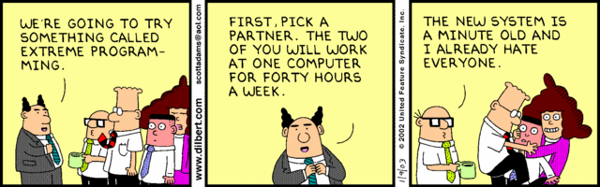
Extreme Programming (XP)
Kent Becks “Extreme Programming” is an extreme agile approach. It encourages
  Very fast iterative development cycles, i.e. a release of S/W every <1 week.
  The idea that requirements change is not something to be feared.
  Design of “test cases and test data” before writing the code.
  Frequent automated rebuilding of the developing code base, sometimes maybe a dozen times a day with checks for pass/fail at each step.
  Program for the here and now – e.g. use an array not a linked list, use a simple slower algorithm not a complex faster one etc, design for now not the future.
  The placement of a customer on site during development.
  “Pair-programming”, i.e. developers working in pairs one focused on strategy/high level algorithms, the other focused on low level design and coding.
Source: Dilbert.com

Slide 30
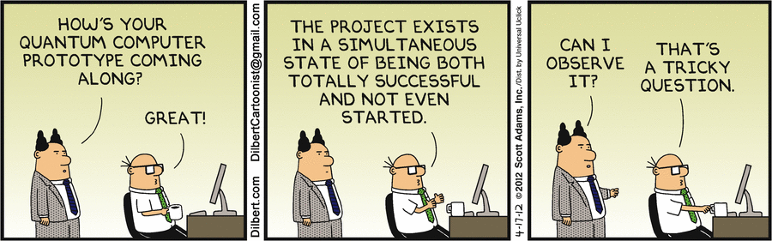
Agile is not a “one size fits all” approach
Agile has it’s sceptics, but it’s currently the favoured approach for many small software development projects in certain fields e.g. web/app type stuff. In fact you could say with the advent of 3D printing, agile approach have also moved into other engineering disciplines e.g. Mech
https://michaelochurch.wordpress.com/2015/06/06/why-agile-and-especially-scrum-are-terrible/
https://www.linkedin.com/pulse/why-agile-doesnt-work-large-projects-stuart-hamilton
http://techbeacon.com/agile-manifesto-dead
http://www.cio.com/article/2385322/agile-development/why-agile-isn-t-working--bringing-common-sense-to-agile-principles.html
Source: Dilbert.com

